Slide 1


2024 PM Election Prediction Analysis
Election prediction analysis is crucial for understanding and foreseeing political trends.
It involves examining various factors like voter demographics, historical data, and regional dynamics.
by Arvinkritik

Slide 2
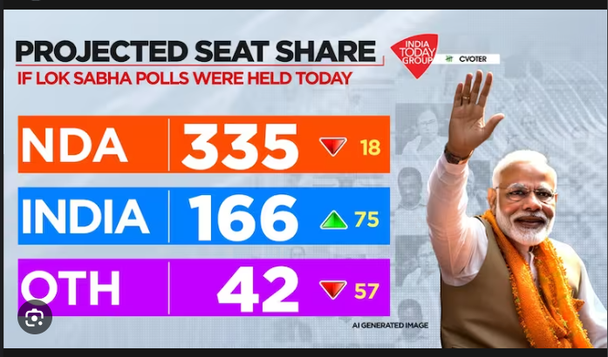
C - Voter Analysis - By India Today

Slide 3
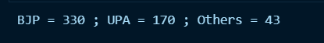
My Analysis - Before Ram - Mandhir
So , the Similarity Percentage BW both Analysis are 99.8%

Slide 4
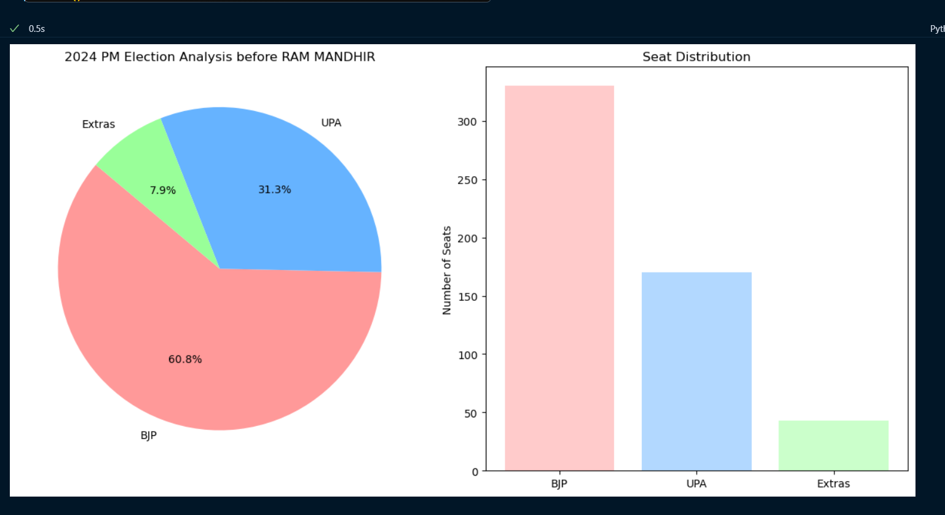


Slide 5
Factors & Sample Size
AI which is Trained
Based on Public Survey and Current Situations , Internet polls ,
Magazine Critizisms that is happening in India.

Slide 6
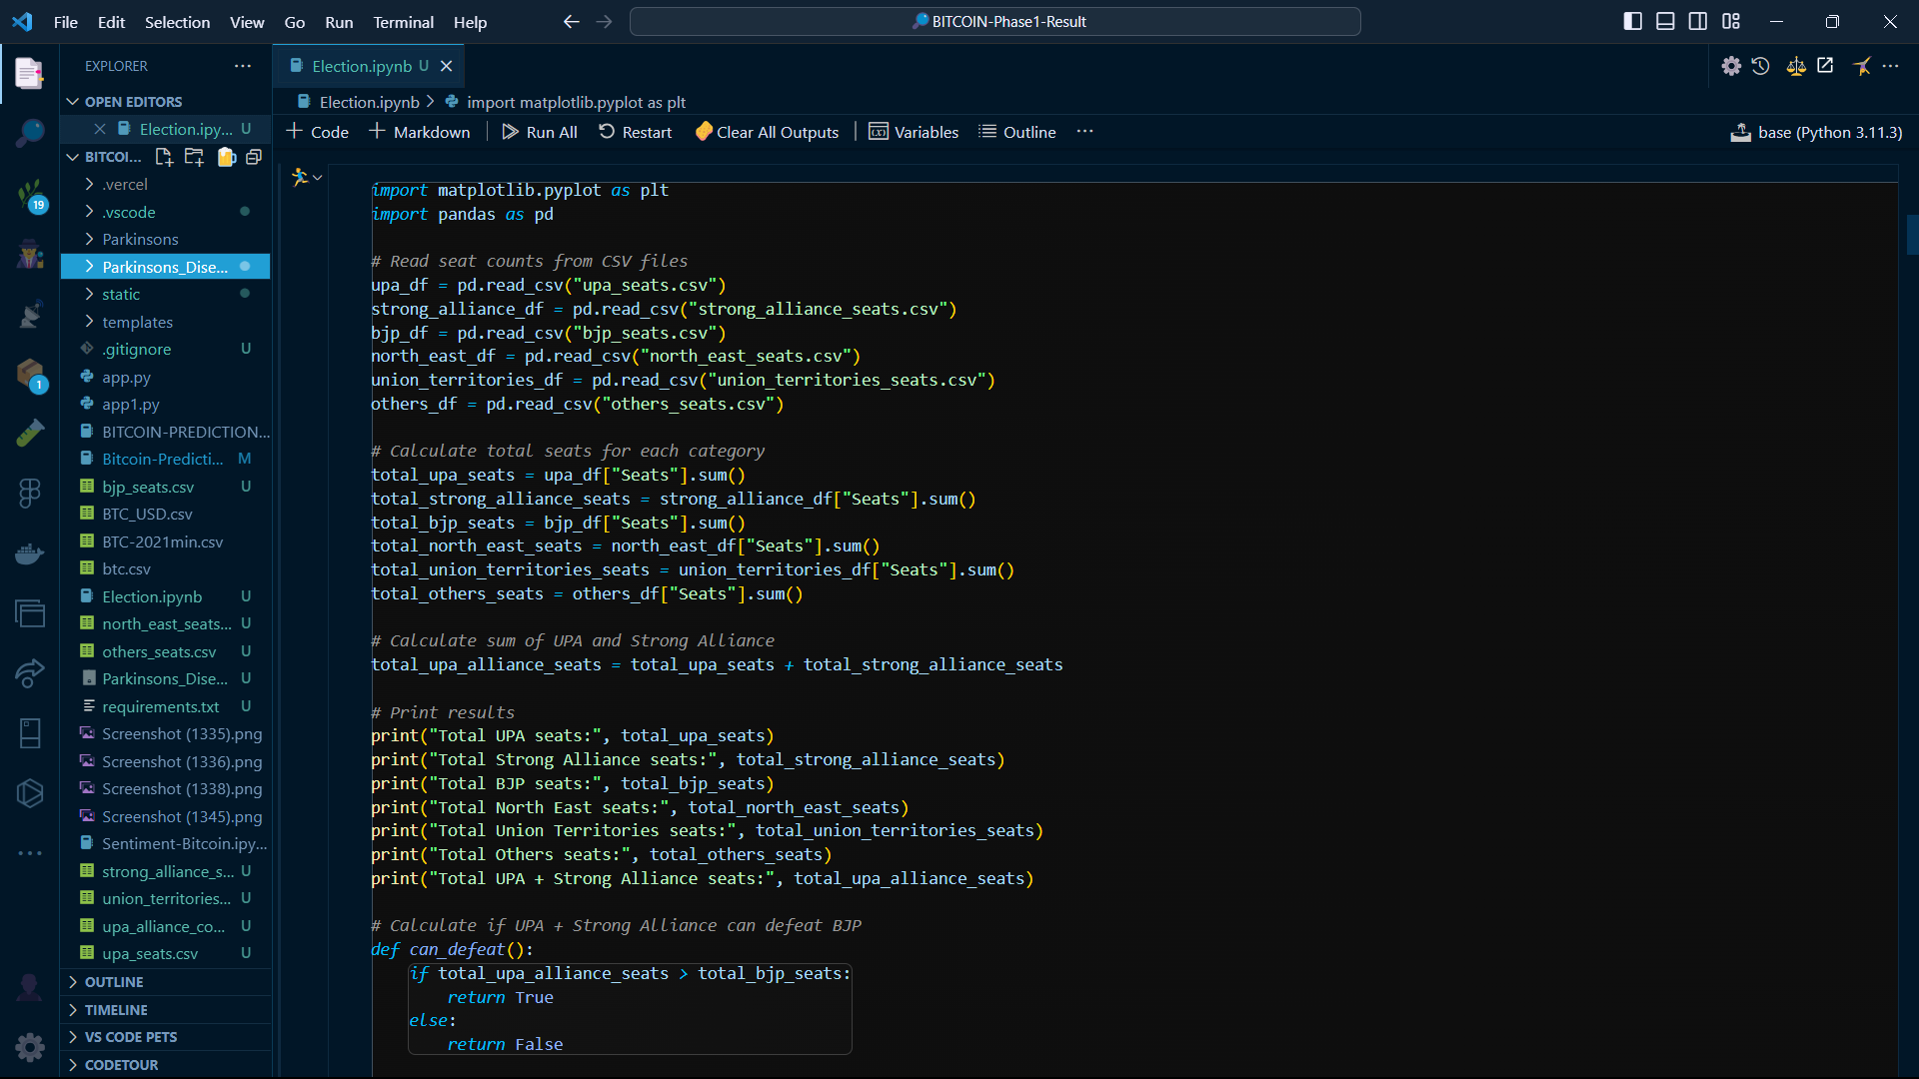
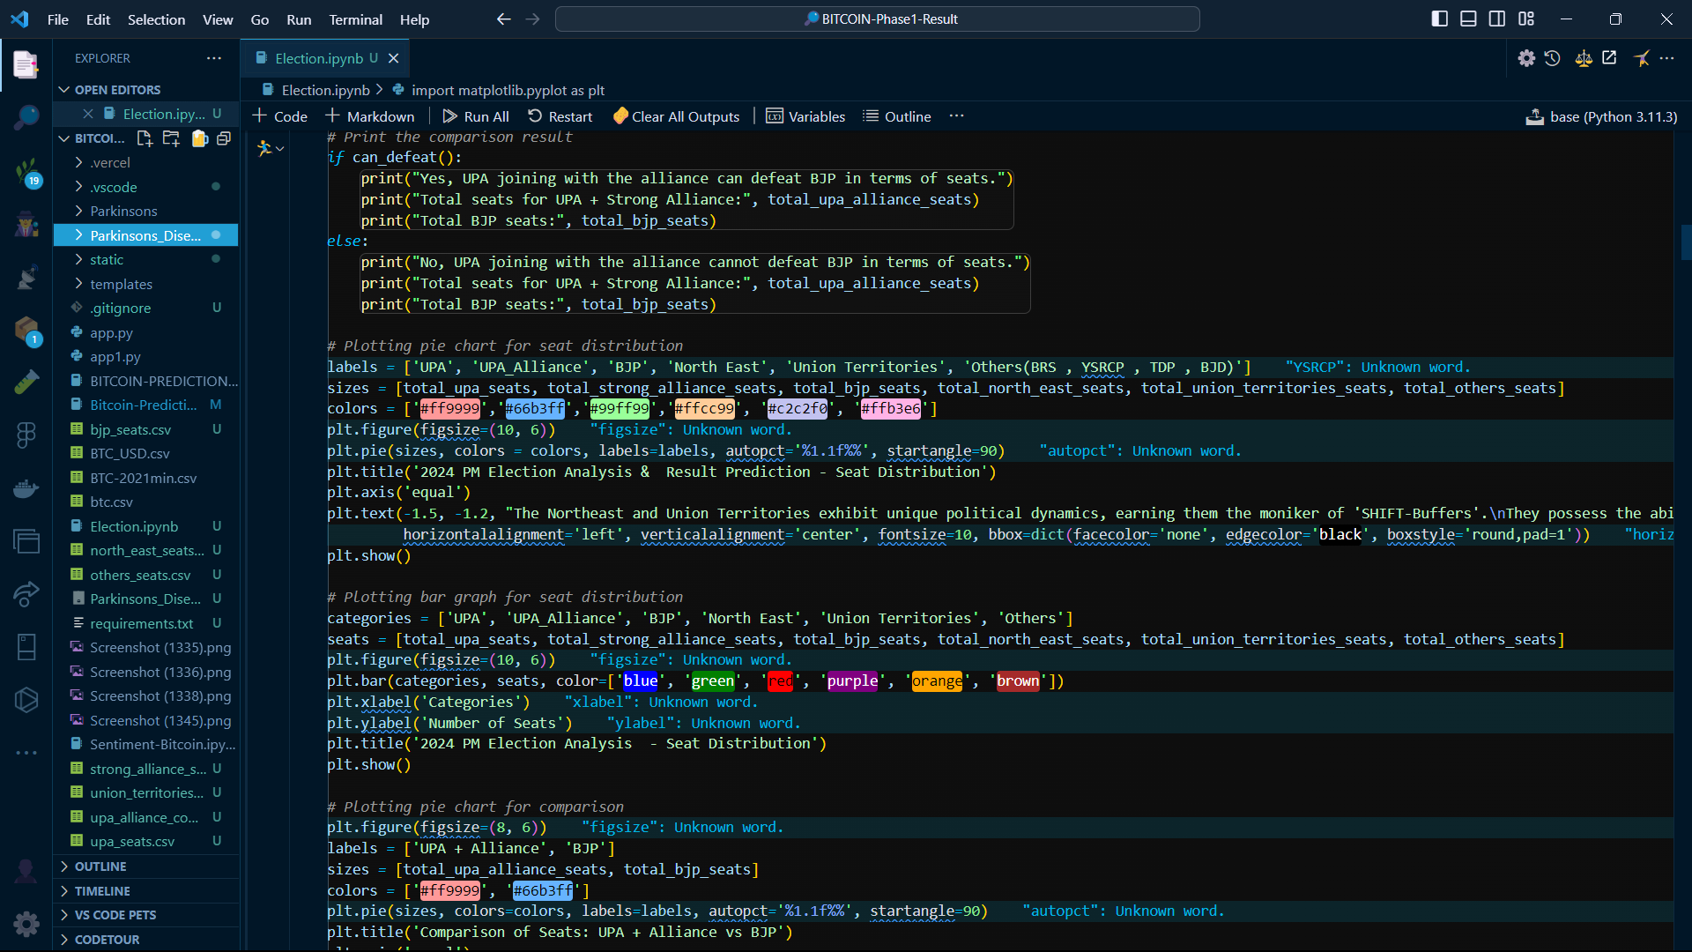
Codes

Slide 7
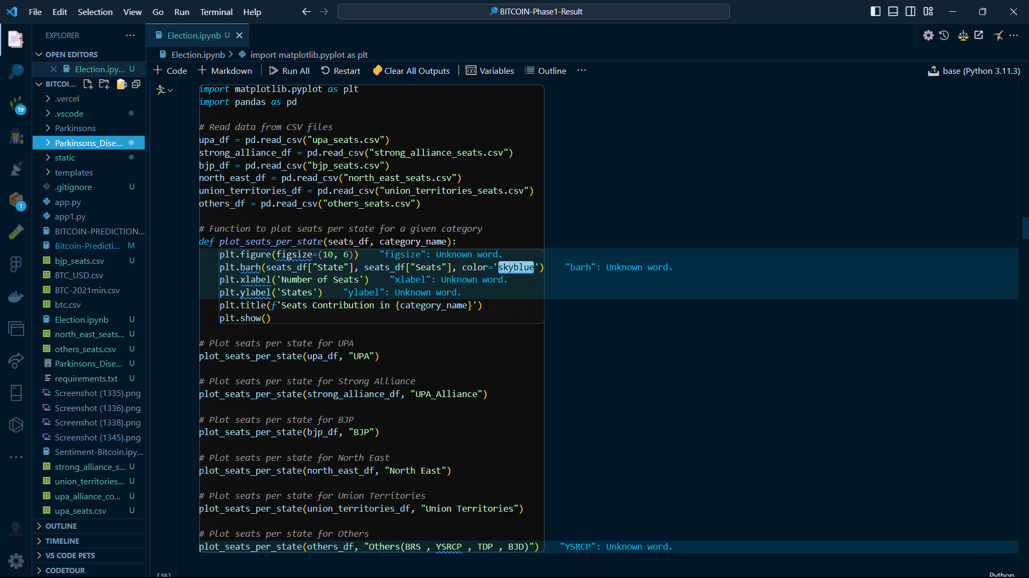
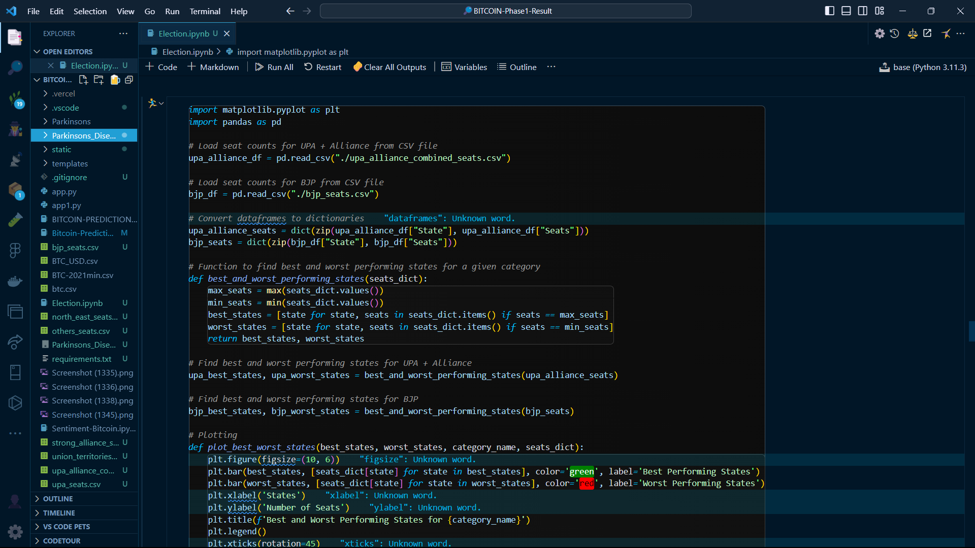
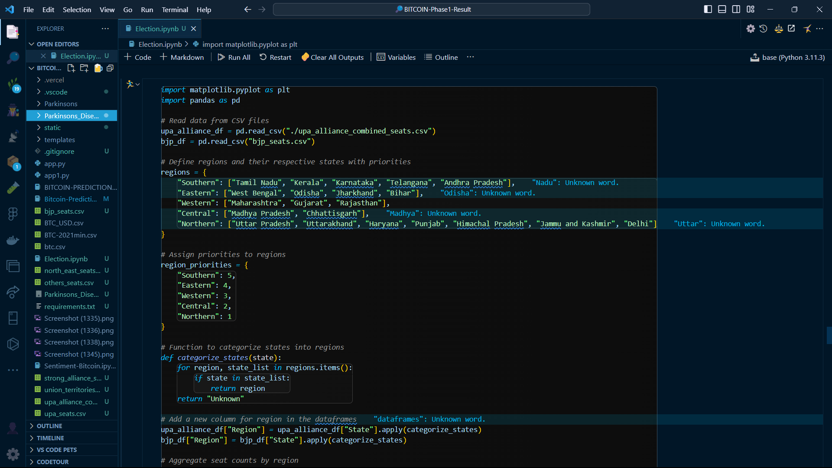
Codes

Slide 8
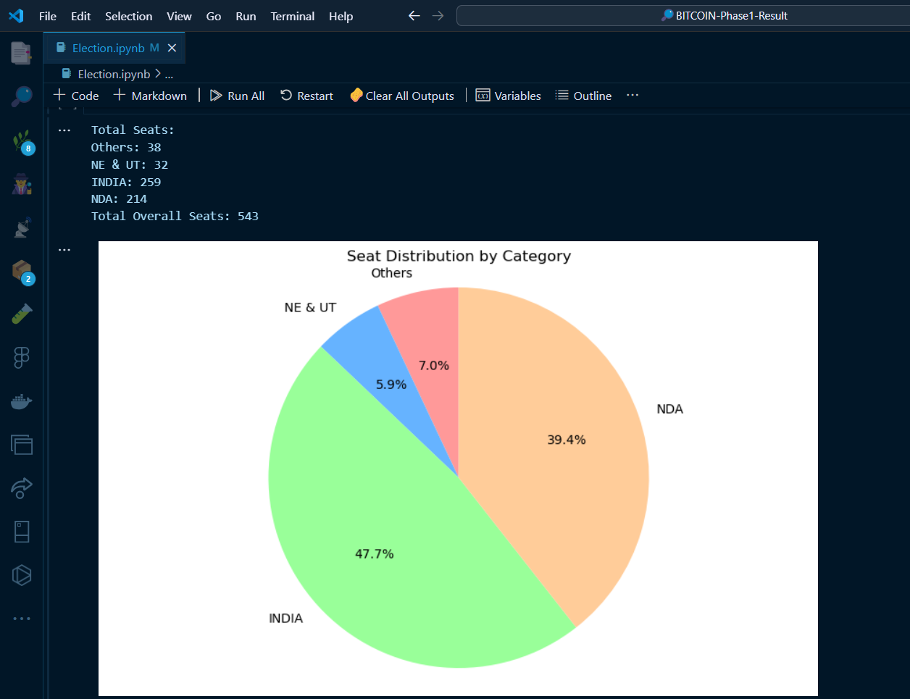
2024 Final Result Prediction & Analysis

Slide 9
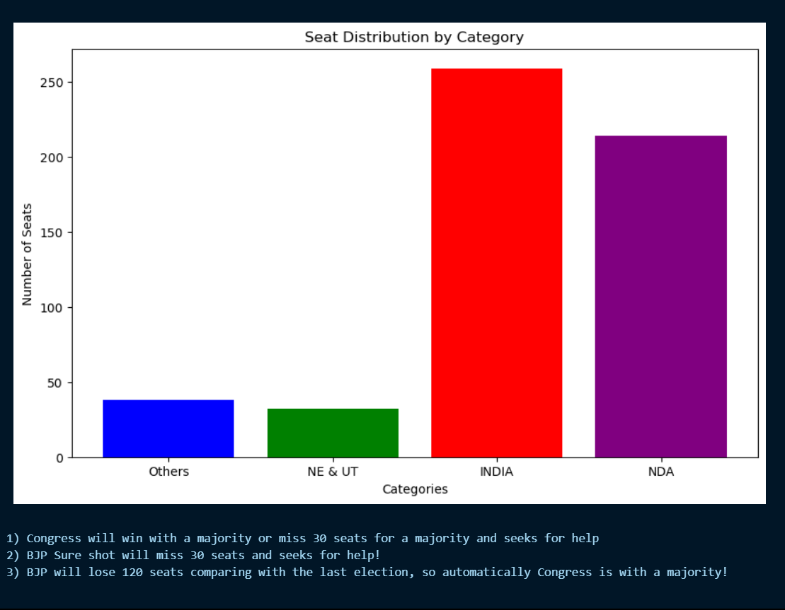
2024 Final Result Prediction & Analysis

Slide 10
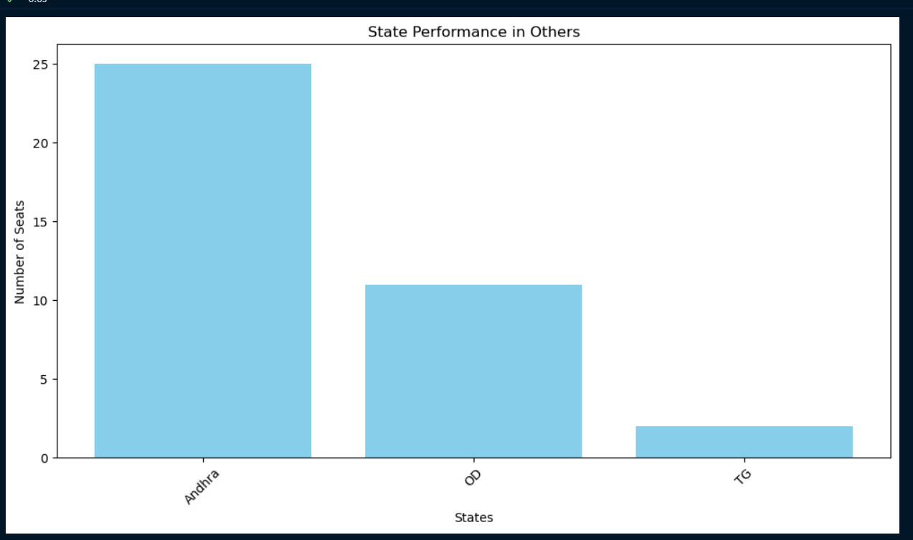
Seat Distribution For OTHERS

Slide 11
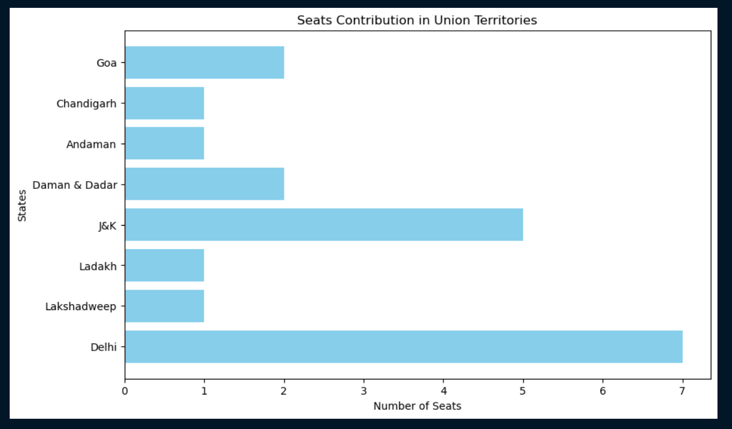
This Analysis didn’t Include North-East & Union-Territories which
contributes 32 Seats. . Because the’re Dependencies r Different

Slide 12
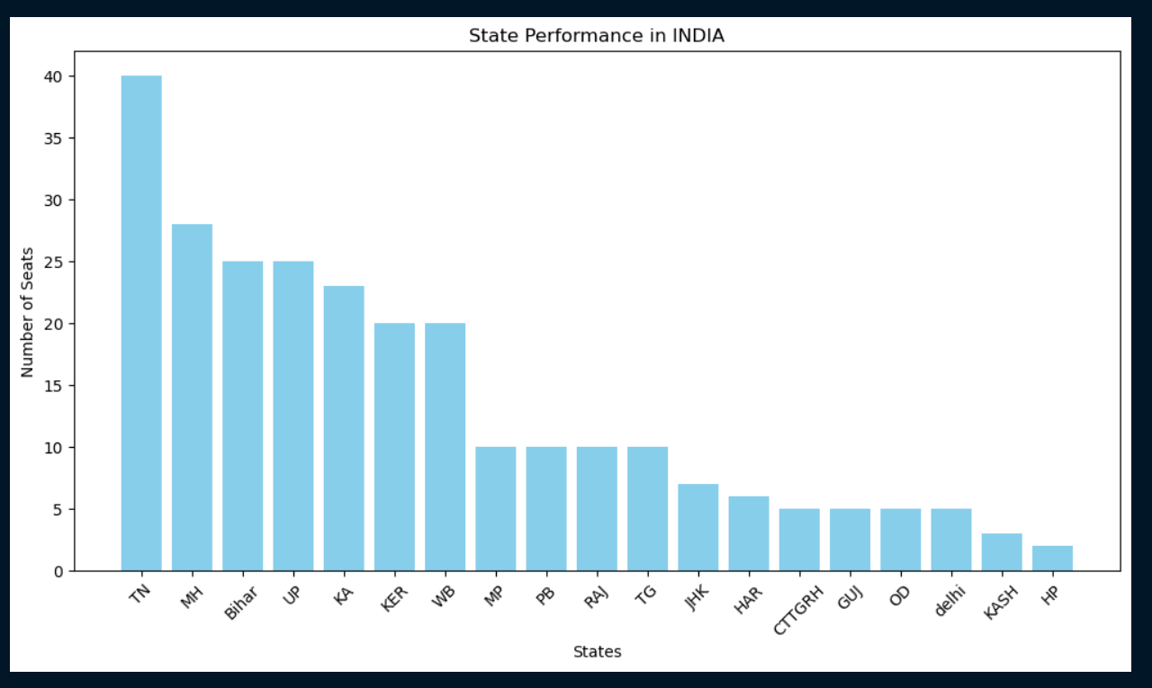
Seats which contributes for INDIA

Slide 13
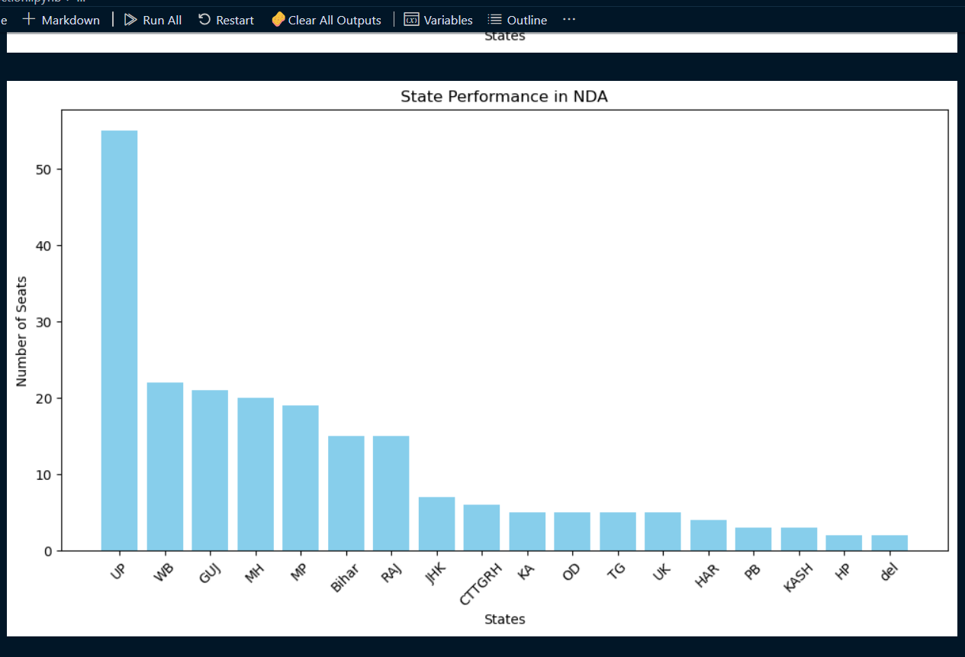
States which contributes more for NDA

Slide 14
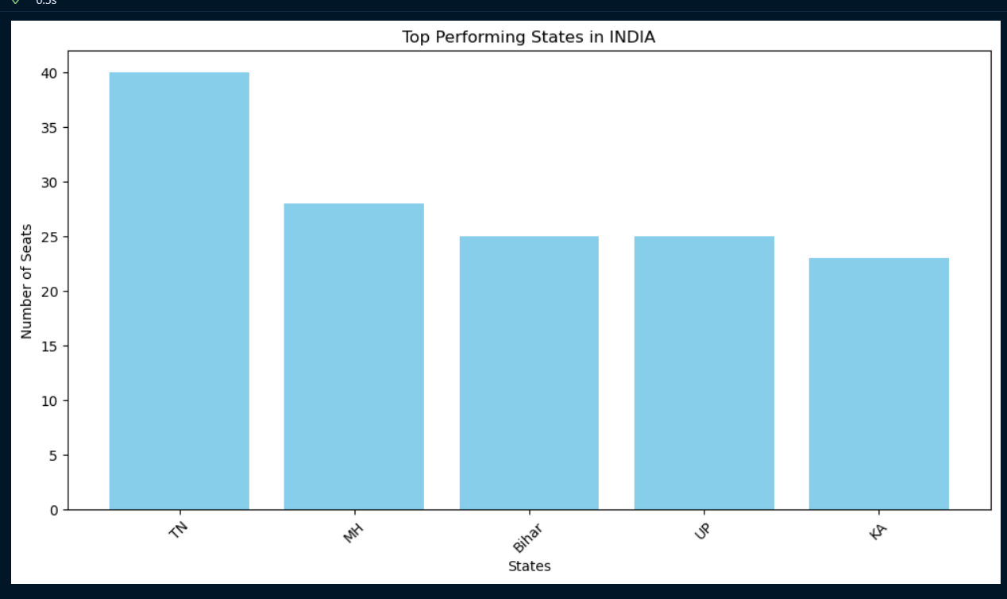
Best performed states by INDIA

Slide 15
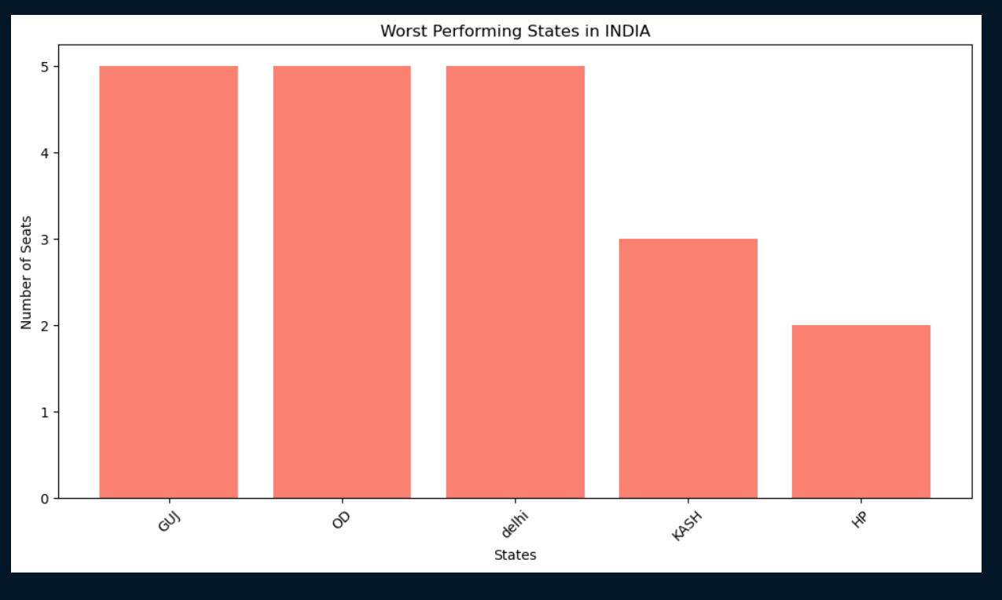
Worst performed states by INDIA

Slide 16
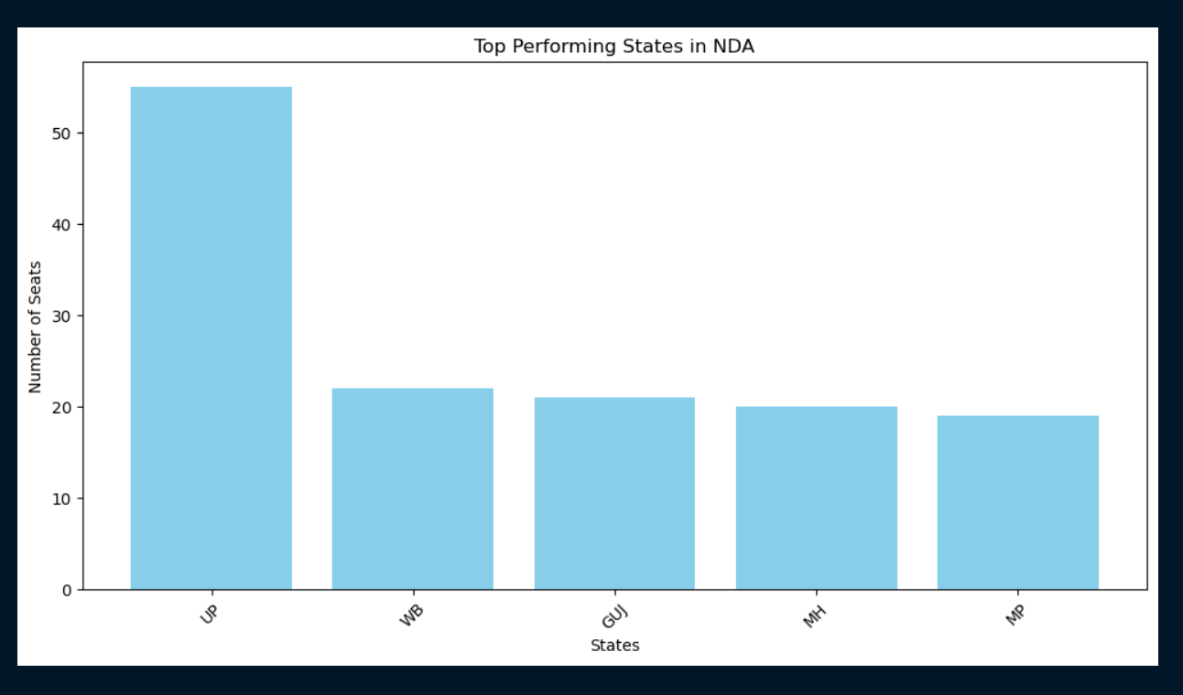
Best Performed States by NDA

Slide 17
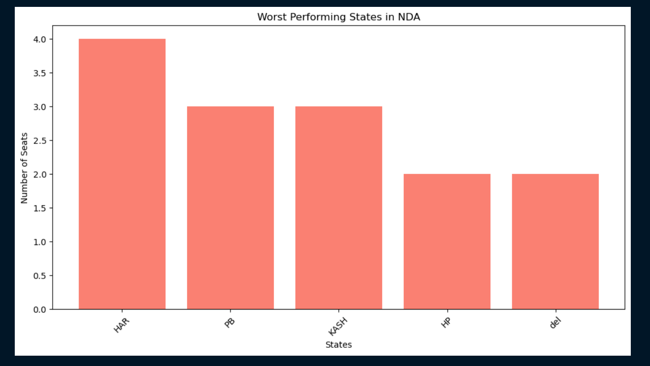
Worst Performed States by NDA

Slide 18
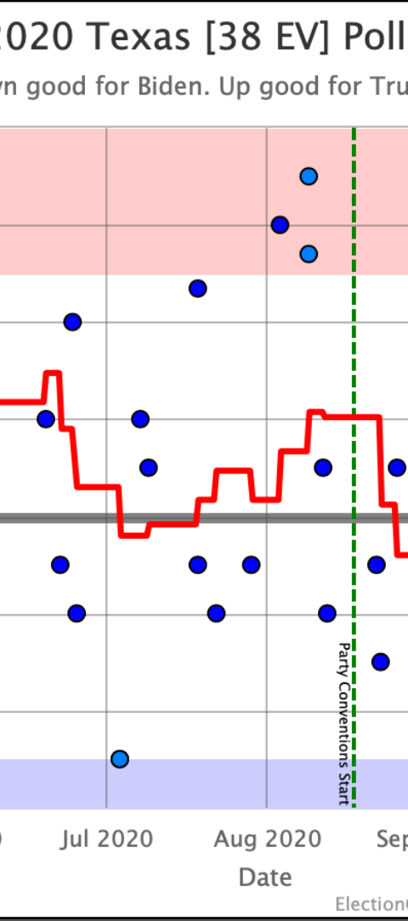

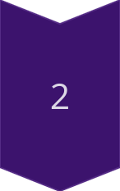
Importance of Shift & Buffers
Understanding Voter Shift
Examining changes in voting patterns and their underlying reasons.
Buffer Strategies
Analyzing strategies to mitigate the impact of unexpected voting shifts.
The North East and Union Territories exhibit unique political Dynamics , earning them the moniker
“SHIFT & BUFFERS”. They possess the ability to sway votes towards a particular party or serve a s a
stabilizing force for a party’s electoral prospects. Additionally the influence of other factors cannot be
Understand in shaping electoral outcomes.

Slide 19
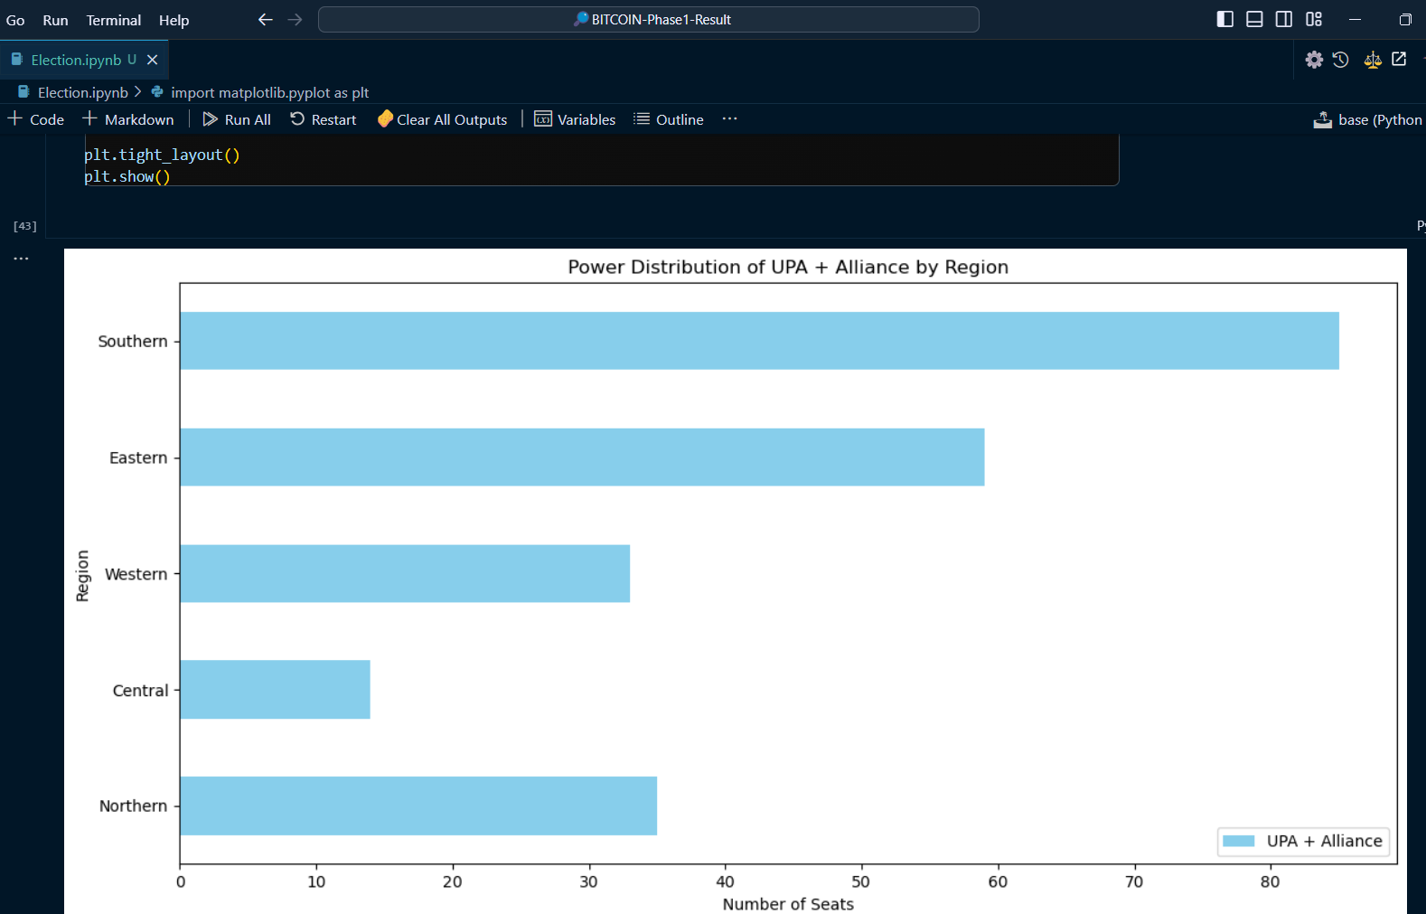
Strong & Weak Areas Of UPA + Alliance by Regions

Slide 20
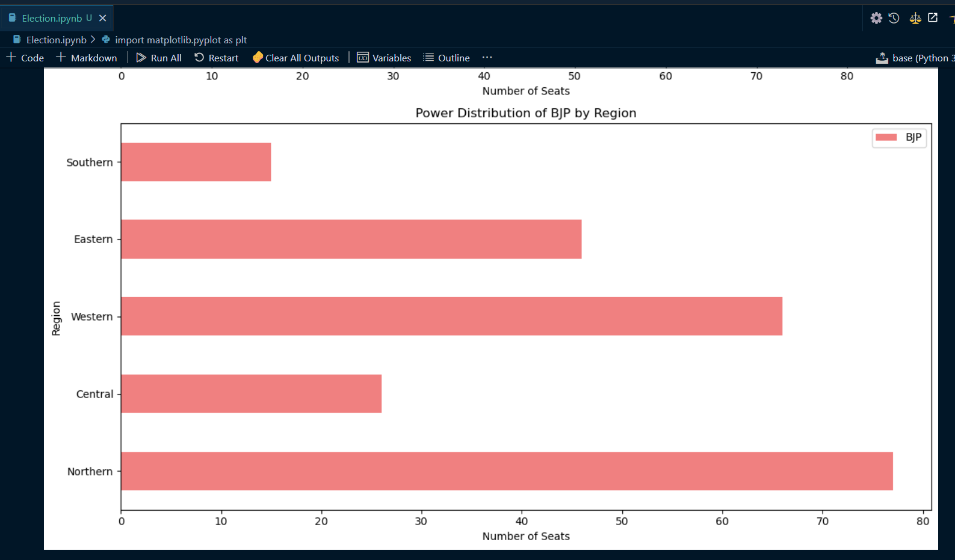
Strong & Weak Areas Of NDA by Regions

Slide 21
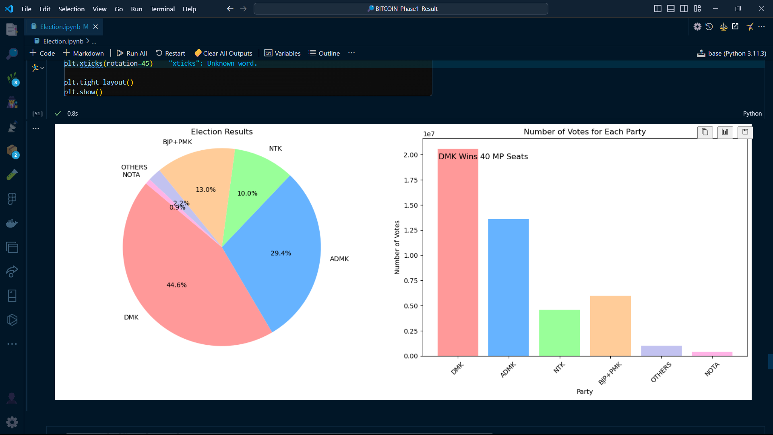
What Results Says in TamilNadu?

Slide 22
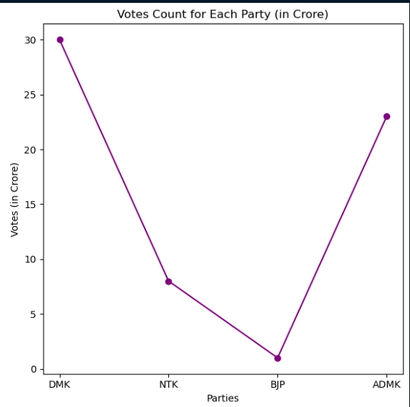
What About Tamil Nadu?
Model Predicts , Its DMK to get full sweep of 40
It shows Vote Count in CRORES

Slide 23
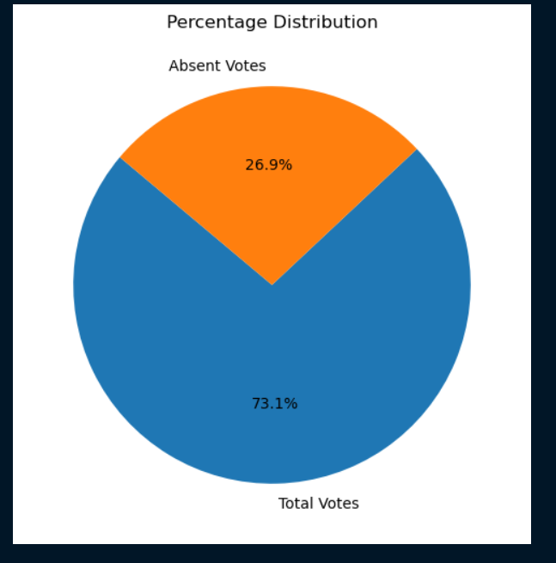
What About Tamil Nadu’s Voter’s Share?
This 26% Votes are not even NOTA votes ,
who didn’t vote for any side , Based on Last Election , Model predicts the percentage of Non-Voters in TamilNadu.

Slide 24
THANK U u

